Slide 1
Emerging Technology Meetup # 3: The Internet of things (IoT)
Date: 2/1/2019

Slide 2
Timeline
INTRO
PRACTICE w/ AZURE IoT
DATABRICKS
Motivations and the Digital Twin
1 Simulated Device
Multiple Devices, Adding 1 physical device
Machine Learning Challenge
45 minutes
10 minutes
20 minutes
15 minutes
TOTAL: 1.5 hrs.

Slide 3
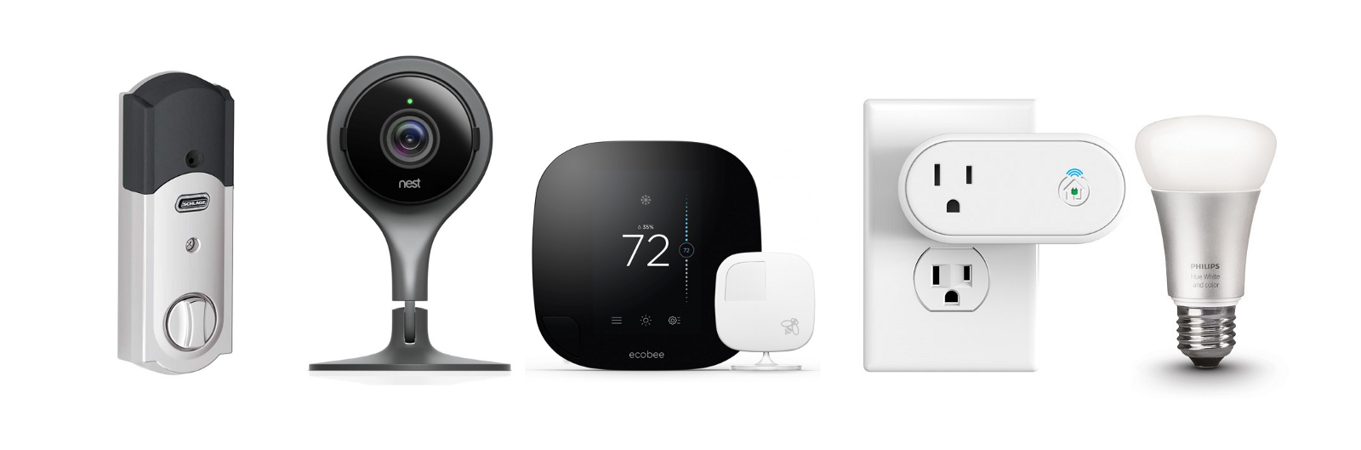
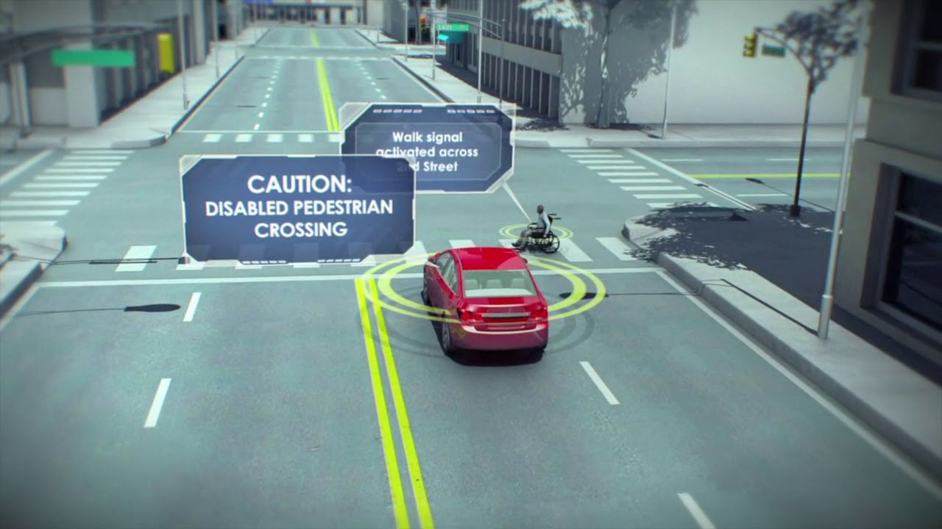
Motivations
We don’t need a Gartner report to see that…
Devices are becoming ubiquitous
Autonomous vehicles, home automation and security, healthcare, wearable tech
The application development rate is rapidly increasing
4 Major, Cloud-Based IoT Hubs (and another dozen second-tier hubs)
>4000 Node-Red Device Flows
Major IoT systems deployments underway
Vehicle technology is pushing the envelope
Autonomous vehicles
V2V, V2I, V2P (V2X)
On top of all that … there is a convergence of technologies
IoT – data generation
Big Data – data storage and analysis
AI/Machine Learning – predictive analytics and control
Blockchain – ecosystems of intelligent agents
https://www.youtube.com/watch?v=QSIPNhOiMoE

Slide 4
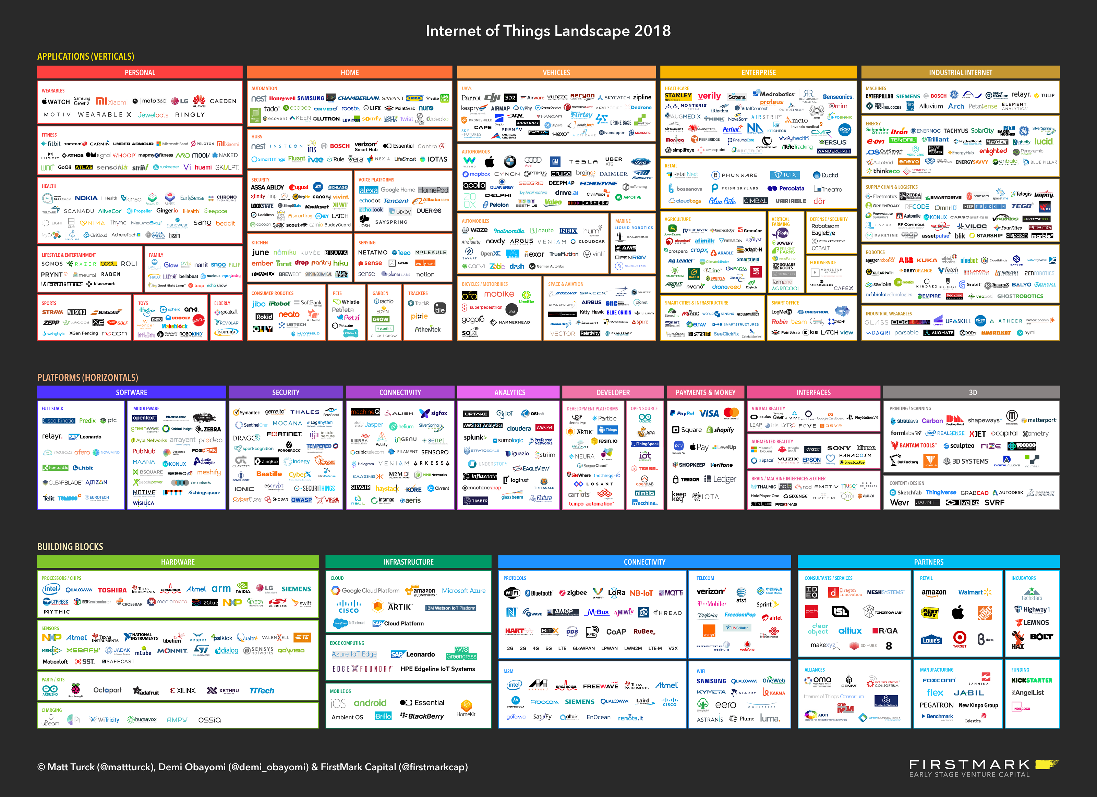
Internet of Things Landscape 2018

Slide 5
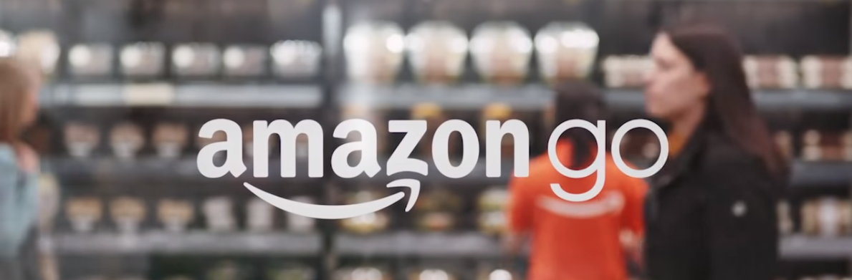
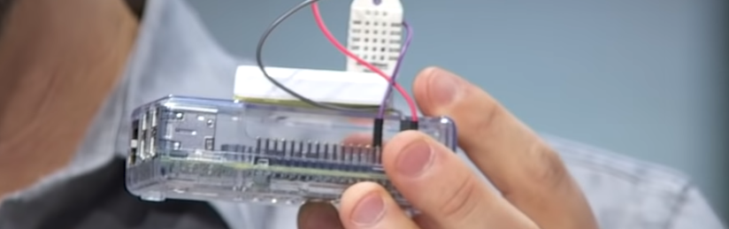
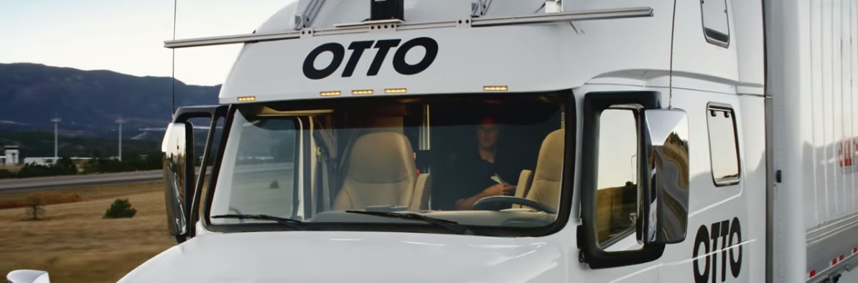
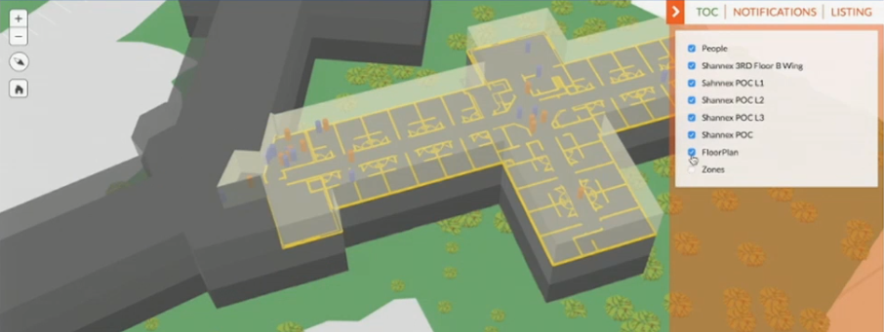
Examples of IoT
Just Walk Out – Amazon Go
https://www.youtube.com/watch?v=NrmMk1Myrxc (1:49)
Rio Tinto - Driverless Train
https://www.youtube.com/watch?v=8A-GAg69rAM (3:24)
Moving Block/Communications-Based Train Control (CBTC)
https://www.youtube.com/watch?v=_1Bgmugve5M (2:11)
Microsoft – Integrating Wearable Health Tech
https://www.youtube.com/watch?v=u5oTz1e5qqE (14:30)
Driverless Vehicles
https://www.youtube.com/watch?v=gfWjsKsEry0 (5:04 – Autonomous Taxi)
https://www.youtube.com/watch?v=Qb0Kzb3haK8 (2:33 – Autonomous Truck)
https://www.youtube.com/watch?v=L_uW0_OvEkk (6:55 – Motivation for Autonomous Trucking)
https://www.youtube.com/watch?v=gD3gXblRhC4 (3:04 – Volvo Platooning/DSRC)
https://www.youtube.com/watch?v=OdhzRJQ7Qfw (3:49 – Logging Operations Platooning/DSRC)
Ford Announced V2X Technology in all Vehicles @ CES 2019
Integration with GIS
https://www.arcgis.com/apps/MapJournal/index.html?appid=895bd00c9e7c4521b21e94da5d4748fc#

Slide 6
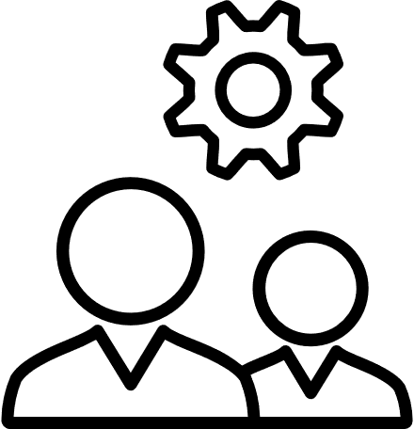
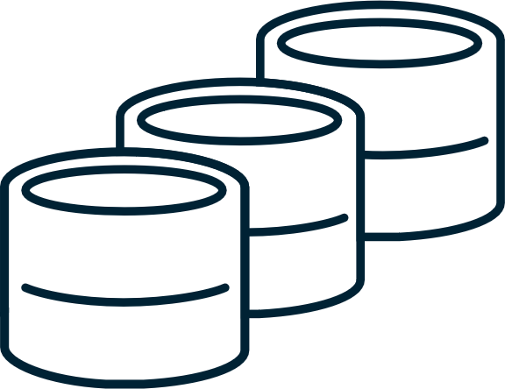

Historical Background
Process Automation – Sensing and Control
Utilities
Industrial Processing
Vehicle electronics
Aircraft
Black Box Perspective
Nobody wants/needs to know about how, e.g. power company checks meters
Protocols/Networks were competitive advantage
Only specialists would need to know
Specialized Languages, Methods, Hardware
Supervisory Control And Data Acquisition (SCADA)
Ladder/Flow Programming (IDE), HMI’s, Data Storage,
Programmable Logic Controllers (PLC)
Logic downloaded from SCADA
Monitored by SCADA
Both Proprietary and Open Network Protocols, e.g. Modbus (request/response messaging)
Industry 4.0 = SCADA + IoT
INFORMATION
TECHNOLOGY
OPERATIONAL
TECHNOLOGY
ERP (ledgers, CMMS, supply chain)

Slide 7

Historical Background, cont.
INFORMATION
TECHNOLOGY
First Wave of Disruption
Personal Computing
Personal weather stations
Home automation/Security
Personal electronics, e.g. Bluetooth devices
Second Wave of Disruption
Cloud-based Integration
Devices became cloud-enabled, e.g. Arlo security cameras
Control Needed to be Personalized
Systems of devices needed to be plug-n-play, e.g. smart home control
OPERATIONAL
TECHNOLOGY
ERP (ledgers, CMMS, supply chain)

Slide 8
Disruption: Merging OT and IT
Honeywell, Rockwell Automation, Allen-Bradley, Siemens (becoming IIoT)
Google, Microsoft, AWS, IBM, Device Manufacturers (IoT & IIoT)
Control Engineering (evolution)
Gen1: Monolithic
Gen2: Distributed (LAN)
Gen3: Networked - Process Control Network (PCN)
Gen4: IIoT – Multi-protocol, Edge, Gateway, Cloud
Security “out of focus” through Gen 2
Server Message Block (SMB) – WannaCry (EternalBlue SMB Exploit)
https://en.Wikipedia.org/wiki/The_Shadow_Brokers
Request/Response Messaging
Low Level Languages
(Relay) Ladder/Flow
A cautionary tale - http://engineeredtruth.com/why-i-have-left-the-plc-programming-field/
Software Engineering
Scalable, distributed computing
Cloud-based storage
IoT Networks
Mesh/Edge/Gateway/Cloud
Availability of complex control paradigms, machine learning, intelligent agents
Security Emphasized
Publish/Subscribe Messaging
Multiple High Level Languages
C#, JS, etc.
TODAY

Slide 9
OT Security Paranoia? Think again…
“It’s a golden age to be an attacker against critical infrastructure. If you are in critical infrastructure you should plan to be targeted. And if you are targeted, you will be compromised. It’s that simple.”
Andy Bochman, Senior Grid Strategist for National & Homeland Security at the Idaho National Laboratory (INL)
Shadow Brokers code release was to be seen as a warning: "Retaliate for the D.N.C., and there are a lot more secrets, from the hackings of the State Department, the White House and the Pentagon, that might be spilled as well. One senior official compared it to the scene in The Godfather where the head of a favorite horse is left in a bed, as a warning."

Slide 10
Acronymn Soup: Protocols and Data Formats
Promising Protocols, Architectures and Standards
Must support addressing, low power, limited data
CoAP/UDP/IPV6/802.15.4 - Constrained Application Protocol
6LoWPAN – IPV6, low power, wireless, personal area network
Emerging reference architectures
Virtually all Cloud-based IoT Hubs implement - Message Queue Telemetry Transport (MQTT) – lightweight pub/sub
Promising Data Formats
Typically JSON over MQTT
https://developers.google.com/protocol-buffers/
Vehicle Safety Specific – DSRC/JSON over WSMP
CAV Specific Network
Wireless Access in Vehicular Environments (WAVE) – 802.11p, J2735

Slide 11



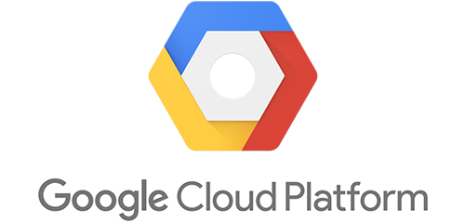
IoT (Hubs) Cloud Gateways on the Scene
Developing the IoT Model: the Generic (Gateway) Hub Approach
AWS IoT
IBM Watson IoT
Google IoT
Azure IoT
Device Definition
Device Provisioning
Digital Twin (aka Device/Shadow/Virtual Twin) – Virtualization of the Physical Device
Data Streams
Ingestion, Storage, and Learning
Focus on serialization/deserialization (aka marshalling)
Integrated Development/Provisioning Environments
AWS IoT
IBM Watson - Node Red
Google IoT Core
Azure IoT

Slide 12





IoT Hubs: Reference Architecture(s)
TM
DEVICES
4. COMPLETE
EDGE HUB
IOT (GATEWAY) HUB
CLOUD SERVICES, APPLICATIONS
&
DIGITAL TWINS
CLOUD ANALYTICS
(ML PIPELINES)
DATA
Zigbee
STREAMING
DATA
1. PREPARE
2. DECIDE
3. COMMIT
1. PREPARE
2. DECIDE
3. COMMIT
1. PREPARE
2. DECIDE
3. COMMIT
Bluetooth
ML MODELS
RM
RM
RM
Wi-FI
CONTROL PROVISION CONFIG
DATA STORAGE

Slide 13
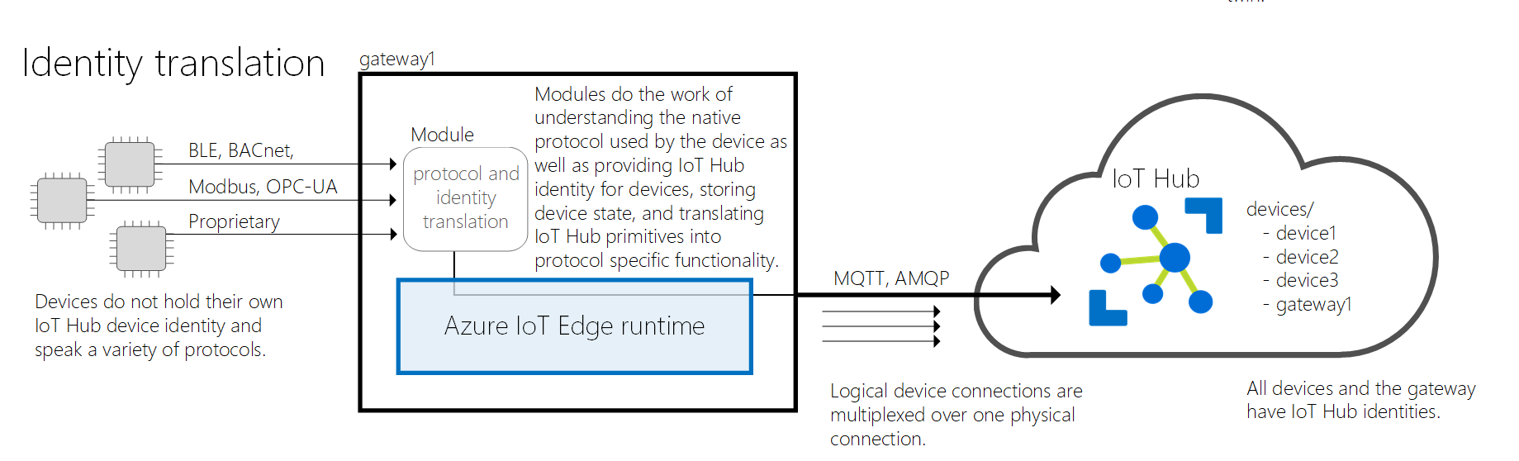
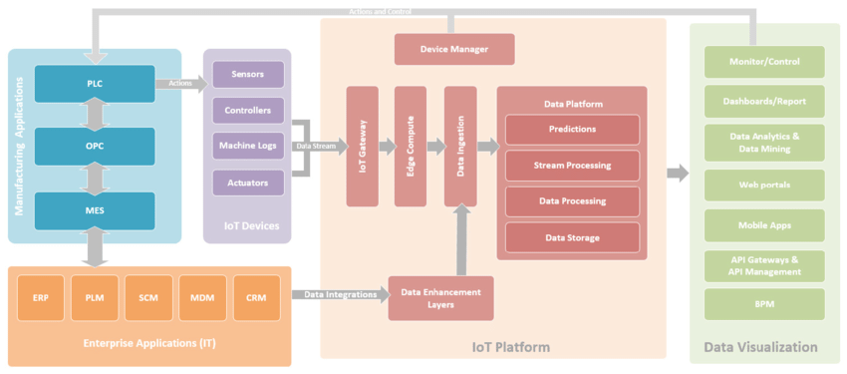

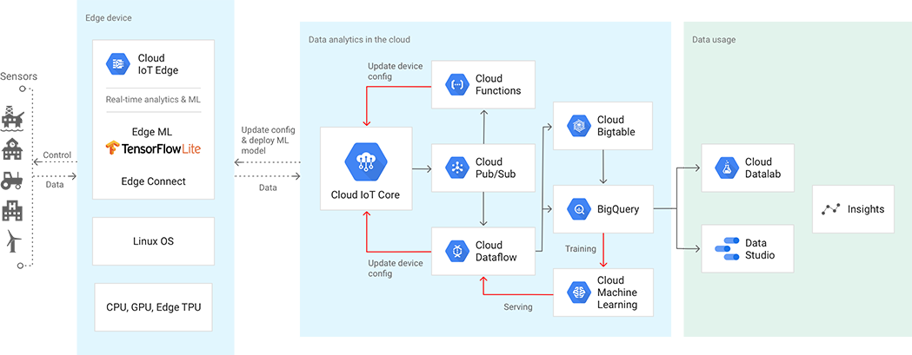
Reference Architectures
https://docs.microsoft.com/en-us/azure/iot-edge/iot-edge-as-gateway
IIoT/Process Automation
IoT Cloud/Edge
https://www.researchgate.net/publication/328007992_Practical_Guide_to_Smart_Factory_Transition_using_IoT_Big_Data_and_Edge_Analytics
https://cloud.google.com/solutions/iot/

Slide 14



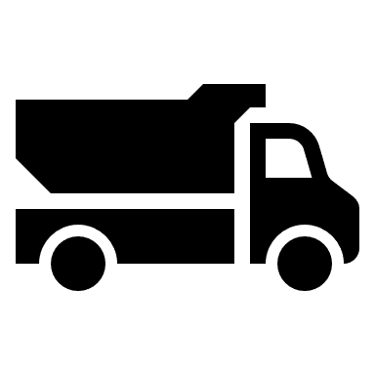
Digital Twin
I’ll control, connect, and provision!
Definition: Digital replication of a physical asset
People, place, device, or system
Implemented as objects, e.g. JSON in Azure
Provides Properties and Settings (over life cycle)
Properties = meta-data, e.g. serialNumber
Settings = setpoints, e.g. targetTemperature
Functional areas
Provisioning
Persisting Device Data
Manufacturer, Serial Number
Handling device settings
Updating based on user input, e.g. new targetTemperature
Controlling Behavior
Indicating desired settings, e.g. comparing desired to required
Releasing new control software, e.g. a newly learned model
Consuming Predictive Analytics Results
Scheduling Preventive and Predictive Maintenance
Time to prioritize and schedule
WORK ORDERS
Digital Twins
Analytics Services
I’m getting an overhaul!
SETTINGS DATA
PERFORMANCE DATA
Here comes telemetry data!

Slide 15
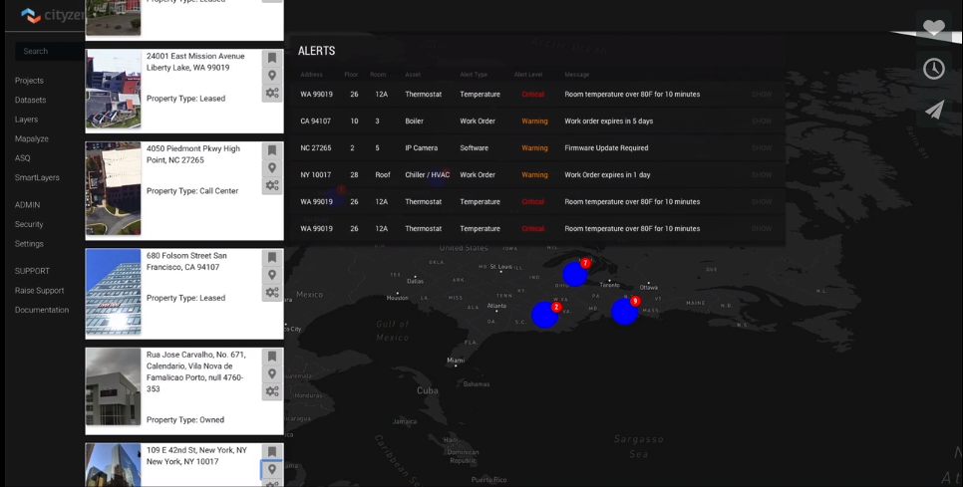
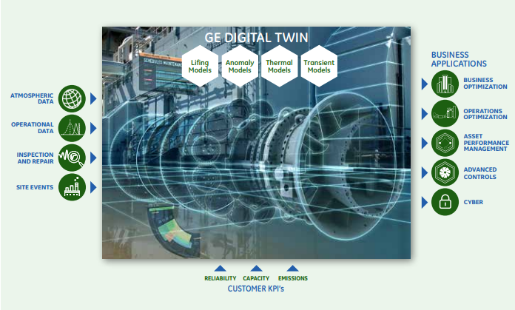
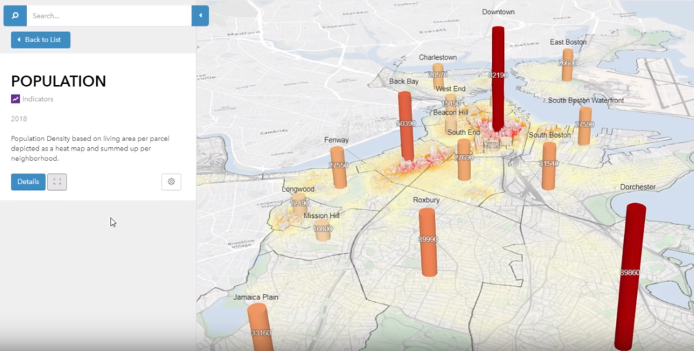
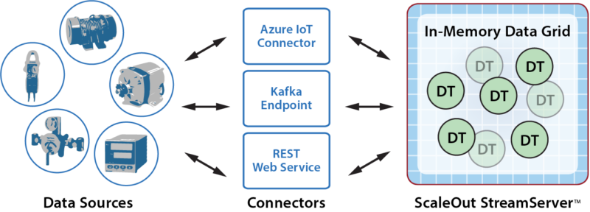
Digital Twins: examples
Facilities
https://vimeo.com/304911148?from=outro-embed
https://cityzenith.com/smartworldpro/digital-twin-solutions/
Industrial Processing
https://www.ge.com/digital/sites/default/files/download_assets/Digital-Twin-for-the-digital-power-plant-.pdf
Government
https://www.govloop.com/community/blog/future-now-3d-digital-twin-government/
Software Environments
https://www.scaleoutsoftware.com/products/digital-twin-builder/?gclid=EAIaIQobChMI6aKA8fyV4AIVj4rICh3esAduEAMYAyAAEgJ8XfD_BwE

Slide 16
Digital Twin: cont.
Digital Twin is typically not:
What’s great about the digital twin?
Sending telemetry data to the IoT hub
Caching telemetry data to persistent storage, e.g. the event hub or DB.
Performing machine learning, i.e. executing a pipeline to generate a model
Offloads non-telemetry/control task behaviors
Manages the life cycle of the device
Stores meta-data about the device
Enables background improvement, e.g. learning

Slide 17

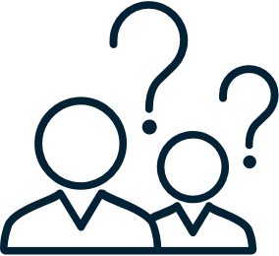
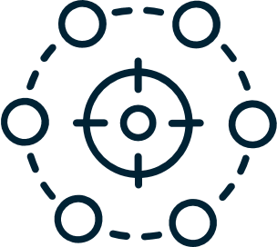
Digital Twin: Provisioning
Bootstrapping
getting ID/metadata
Credentialing – secure authenticated communications
Acquiring a token
Authorization – acquire persmissions
Permission + Credential → Resources
Connecting
Establishing network connectivity
Registration
Being known to other resources

Slide 18

Convergence with Emerging Tech
Big Data
Streaming IoT data often results in large datasets
Learning in both real-time (streaming) and off-line (batch) modes
Learning opportunities for predictive analytics (graceful failures, pre-emptive repair) and control (adapting to machine usage)
Blockchain
Devices are typically part of an ecosystem
Ecosystem might include transactions, e.g. paying for usage
Smart Contracts provide business logic layer
Log data for private usage should be both private and secure (audits)

Slide 19
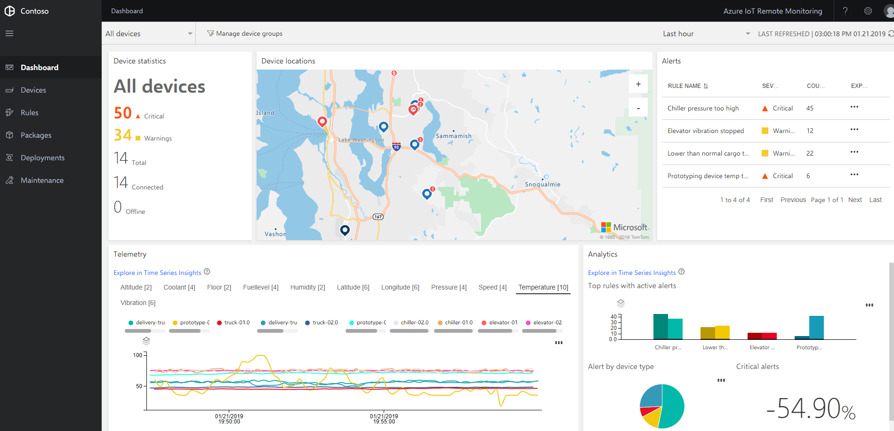
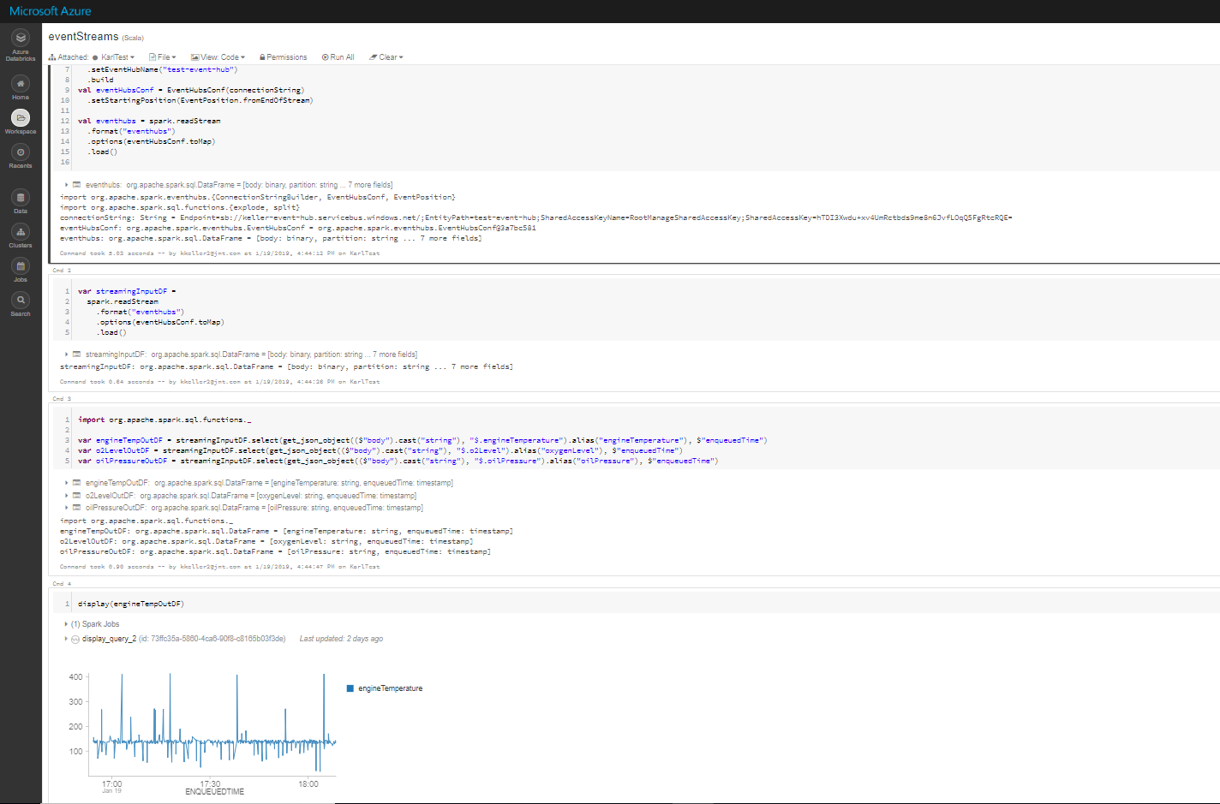
Demonstrations
Remote Monitoring
Simulated Devices
Telemetry to Dashboard
Using Time Series Insights
Data Analytics
Event Hubs Data Capture
Databricks Evaluation

Slide 20
Next Steps: Meetup Challenge
Big Data from IoT is just a lot of data…without Machine Learning!
Pick a domain
Environmental Monitoring
Freight Movement
Waste Water Treatment
Propose something to learn from your data
See your machine learn at the next meetup!

Slide 21

Picking a ML Paradigm

